Slide 1
Meeting 2
Group 2

Slide 2
Data Model
Conceptual Data Model (CDM) that explains the entities and relationships.
Logical Data Model (LDM) that explains all of the required attributes that fully describe their entity which are required to be maintained by the application.
Physical Data Model (PDM) that explains all of the Tables and foreign keys with their cardinality.
Isolate table and foreign key relationships in subject areas.
Show the User Defined Datatypes as part of the PDM.

Slide 3
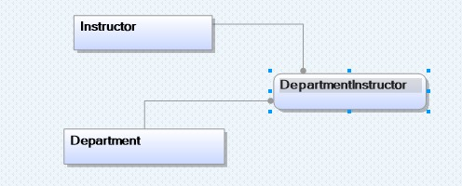
CDM

Slide 4
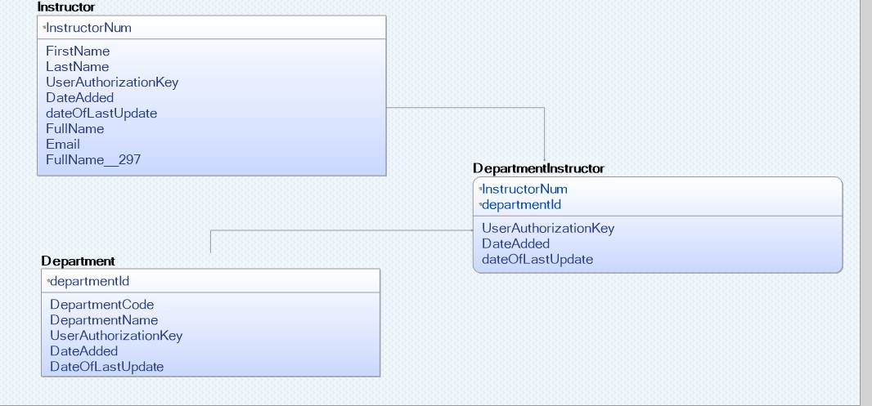
LDM

Slide 5
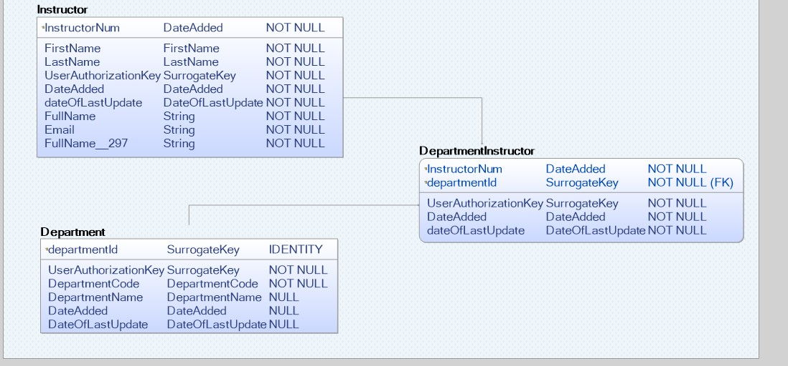
PDM

Slide 6
Workflow
Drop Foreign Keys > Truncate Tables > Load Individual Tables > Add ForeinKeys
SSMS Demonstration

Slide 7
JDBC
Create queries with propositions that support your design decisions (2 per person) and load the output into JTable for presentation in the video
Project3.LoadQueensCourseSchedule
Process.usp_ShowWorkflowSteps and load the output into JTable for presentation in the video
Eclipse Demonstration

